Slide 1
Predicting Customer Churn in Telecom Industry using Power BI and SQL

Slide 2
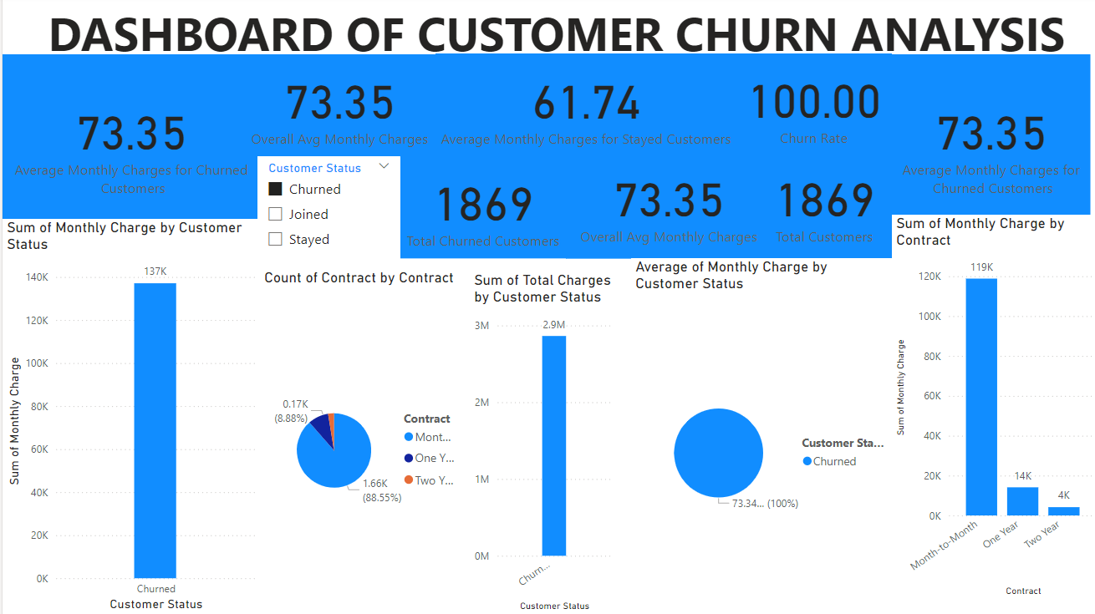

Slide 3
Insights:
Overall Customer Churn:
Total Customers: 1,869
Churned Customers: 1,869 (100% churn rate)
Stayed Customers: 0
Insight: Every customer has churned. This could indicate a significant issue with customer retention, perhaps related to service quality, pricing, or competition.
Average Monthly Charges:
Churned Customers: $73.35
Stayed Customers: $61.74
Insight: The average monthly charge for churned customers is higher than that for stayed customers. This suggests that customers paying higher rates may be more likely to leave, potentially due to perceived lack of value for money.
Sum of Monthly Charges by Customer Status:
Total Monthly Charges from Churned Customers: Approximately $137K.
Insight: Churned customers represent a significant portion of monthly revenue. Losing these customers impacts the company's recurring revenue.

Slide 4
Total Charges by Customer Status:
Total Charges from Churned Customers: $2.9M
Insight: This indicates the lifetime value lost due to churn is substantial.
Contract Type Analysis:
Contracts by Type:
Month-to-Month: 88.55% of churned customers
One Year: 8.88% of churned customers
Two Years: 2.57% of churned customers
Sum of Monthly Charge by Contract:
Month-to-Month: $119K
One Year: $14K
Two Years: $4K
Insight: The majority of churned customers are on month-to-month contracts, which are likely easier to exit. This indicates a potential vulnerability in shorter-term contracts.

Slide 5
Business Recommendations:
Customer Retention Programs:
Target High-Charge Customers: Since churn is higher among customers with higher average monthly charges, consider offering discounts, loyalty programs, or added benefits to customers with high monthly charges.
Enhance Value Perception: Improve the perceived value for high-paying customers by introducing premium services or bundling offers that enhance their experience.
Contract Restructuring:
Promote Longer-Term Contracts: Since churn is predominantly from month-to-month contracts, incentivize customers to sign longer-term contracts by offering discounts or additional services for committing to a yearly or bi-yearly plan.
Introduce Flexibility in Contracts: Offer flexible terms within longer contracts to make them more appealing, such as the ability to upgrade or downgrade services without penalties.
Customer Feedback and Experience Improvement:
Conduct Exit Surveys: Implement exit surveys for churned customers to understand their reasons for leaving. Use this data to make targeted improvements.
Improve Service Quality: Identify common pain points and invest in improving service quality, particularly for those on higher plans who are more likely to churn.

Slide 6
Monitor and Predict Churn:
Implement Predictive Analytics: Develop models to predict churn based on factors like monthly charges, usage patterns, and customer engagement. Proactively address issues with at-risk customers.
Segment Analysis: Analyze customer segments more deeply to identify if specific groups (by age, geography, usage pattern, etc.) are more likely to churn and tailor strategies accordingly.
Customer Support Enhancement:
24/7 Support for High-Value Customers: Consider providing round-the-clock support or dedicated account managers for high-paying customers to improve satisfaction and retention.
Proactive Engagement: Regularly check in with high-risk customers (based on predictive analytics) to address concerns before they consider leaving.

Slide 7
Summary Of Analysis
Based on the Analysis
•The greater number of Churned customers were come under the month-to-month contract type.
•The greater Amount of monthly charges paid by the Stayed customers.
•The Most Total amounts were paid by the Churned Customers.
•Among the Total Customers 26.5% customers were Churned During That period.
•The Avg Age of the Churned Customers were 49.75yrs.
•The Avg Monthly Charges paid By the Churned Customer were $73.35.
•The Churn rate of this analysis were 26.54.

Slide 8
Conclusion:
The dashboard highlights a critical issue with customer churn, particularly among those on month-to-month contracts and those with higher monthly charges. By focusing on enhancing customer value, offering more attractive contract terms, and using data-driven approaches to predict and prevent churn, the company can work toward improving customer retention and stabilizing its revenue base.

